Slide 1
Employee SKILL TRACKER
By Darryl Katwaroo

Slide 2
background
A telecommunications company that deals with the installation and troubleshooting of enterprise data and voice networks.
People - Manager, Lead Technician, Technicians
Jobs involve cabling, installing network hardware , diagnosing and repairing any network problems.

Slide 3
Problem
During an interview with the lead technician, the following data was gathered:
Jobs are taking too long to be completed
Customers are not 100%satisfied with work done
New workers have to be hired
Work ends up being rushed
Work hours extend

Slide 4
Problem cont’d
It is clear that the performance of the employees is not meeting the expectations of the lead technician

Slide 5
Solution: - Web application
zero in on weaker employees. Training or other action could be taken to improve their skill level.
zero in on the stronger employees. Stronger employees could be allocated to complete larger or more urgent projects.
higher quality work
more competent workforce
less wasted time and resources – increase productivity by sending a sufficient number of workers to sites.

Slide 6
How proposed solution will fix problem
Problem
solution
Jobs are taking too long to be completed
Customers are not 100%satisfied with work done
New workers have to be hired
Work ends up being rushed
Work hours extend
reduce time and productivity lost
Higher quality of work
Current workers could be trained
Timely completion of projects

Slide 7
Why web app?
Accessibility
Scalability

Slide 8

Similar applications – liaison
Skills Database - tracks skills of employees, used for evaluation purposes, figure out what types of training needs to provided.
Employee Profiles - employees can view other employees.

Slide 9
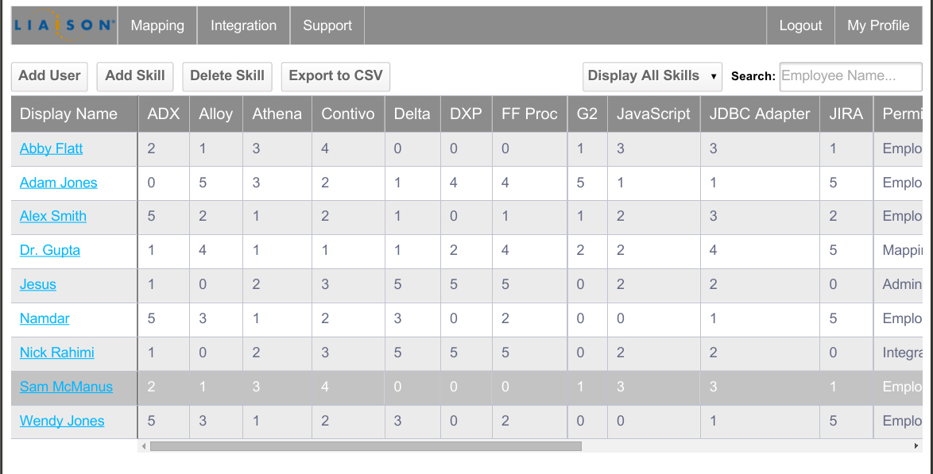

Slide 10
Similar applications - ABC Employee Skill Tracker
View number of employees possessing each skill (dashboard, pie chart) -admin
View each employee’s skill level in each skill (dashboard, bar chart)-admin
View Employee information in a table -admin
View Employee information profile –admin, employee
View table showing employee skills
Overall average skill level in all skills
Add employee
Add skill
Edit Employee personal information
Search employees by name and view employee personal data as well as skill data

Slide 11
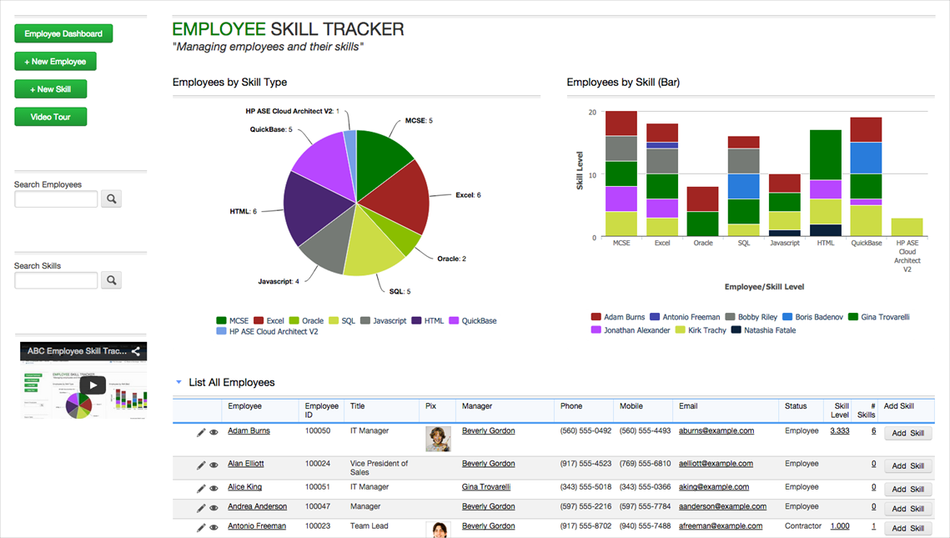

Slide 12
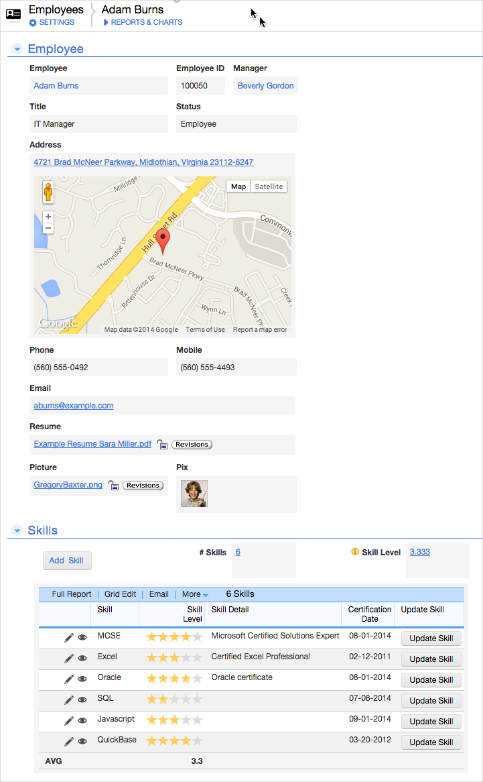

Slide 13
Initial scope
FUNCTIONALITIES AND THEIR USER GROUPS

Slide 14
User | Function
MANAGER | Register technician Delete a technician personal data Delete a technician skill data Update a technician personal data Update a technician skill data Login Logout Search for technician by name Post comments View technician profile Delete comments View comments Assign an overall rating to technician View technicians by overall rating (e.g. on a scale of 1-10, view technicians with a rating of 8-10 or 1-3)

Slide 15
User | Function
LEAD TECHNICIAN | Register technician Delete a technician skill data Update a technician skill data Login Logout Search for technician by name Post comments View comments View technician profile Assign an overall rating to technician View technicians by overall rating (e.g. on a scale of 1-10, view technicians with a rating of 8-10 or 1-3)

Slide 16
User | Function
TECHNICIAN | Login Logout Post comments View comments View technicians by overall rating (e.g. on a scale of 1-10, view technicians with an overall rating of 8-10 or 1-3) View technician profile Search for technician by name

Slide 17
Technologies
php – to manage data in MySQL database
plenty online tutorials and forums for support
reliable due to its age
many databases supported
platform independent
open source
familiar

Slide 18
Technologies cont’d
MySQL database –
popular
easy to learn,
supported across many environments or OS
works well with php
familiar

Slide 19
Technologies cont’d
css –styling, free, familiar
html – go to language for web development, free easy to learn , support
Js – familiarity, free, for making dynamic content such as dropdowns, validation
None of the listed languages require any special software.
Experience working with these languages is high

Slide 20
Technologies cont’d
xampp
Apache web server
php
MySQL database
phpMyAdmin

Slide 21
designs

Slide 22
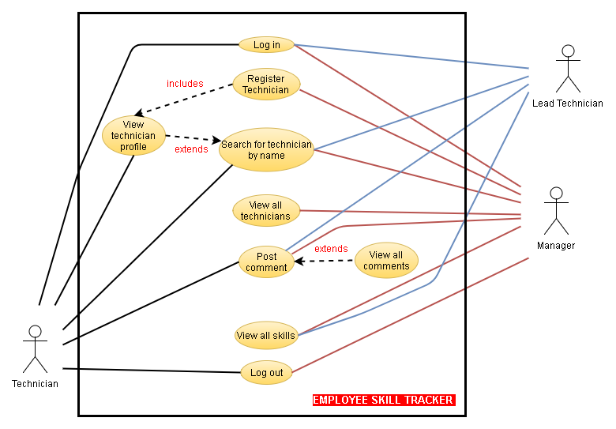

Slide 23
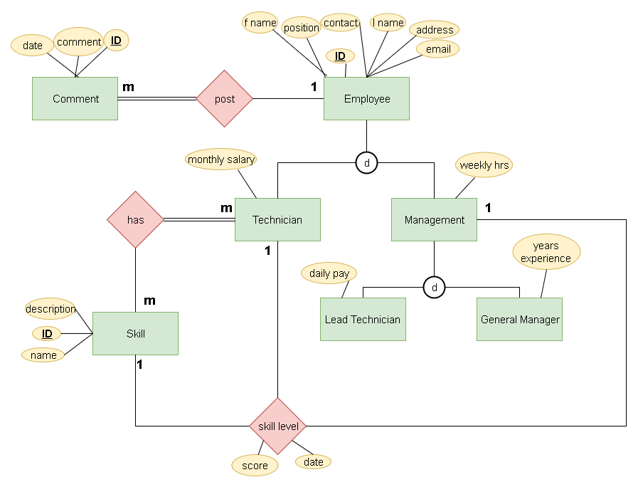

Slide 24
Entity Relationship Diagram
Assumptions:
Every comment must be posted by an Employee
An employee may or may not post a comment
Many technicians can possess the same skills
A skill may or may not be possessed by 0 technicians
An employee must be a technician, a member of management or another position. They cannot fill more than one position

Slide 25
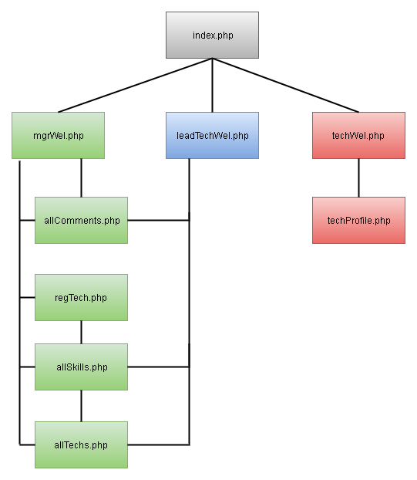

Slide 26
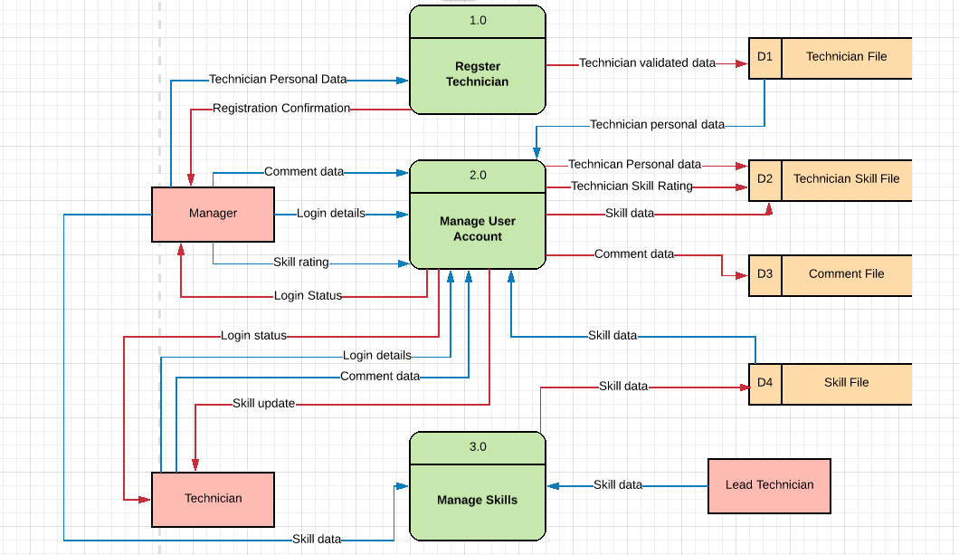

Slide 27
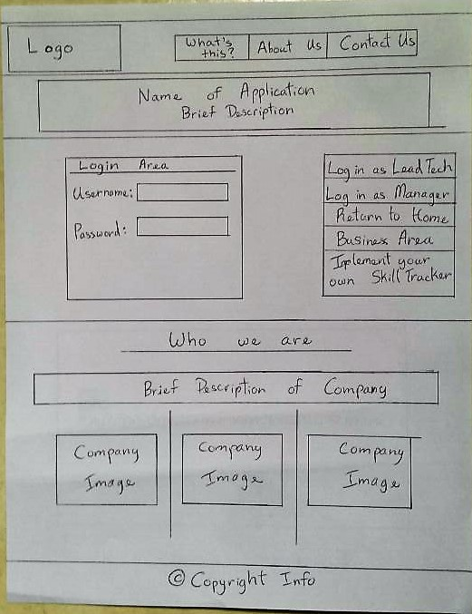

Slide 28
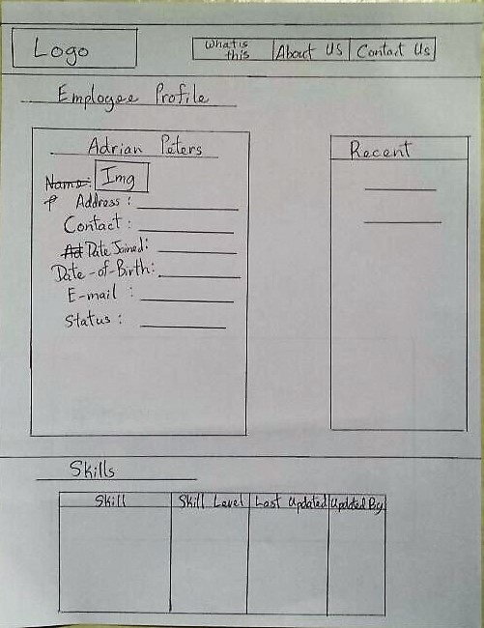

Slide 29
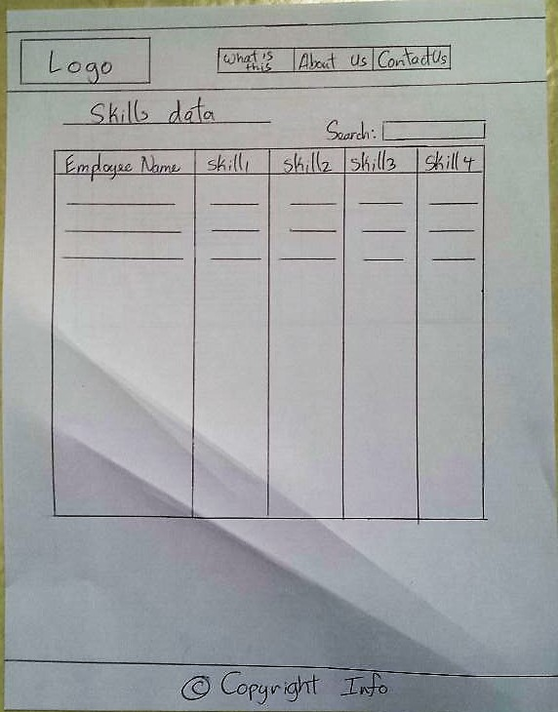

Slide 30
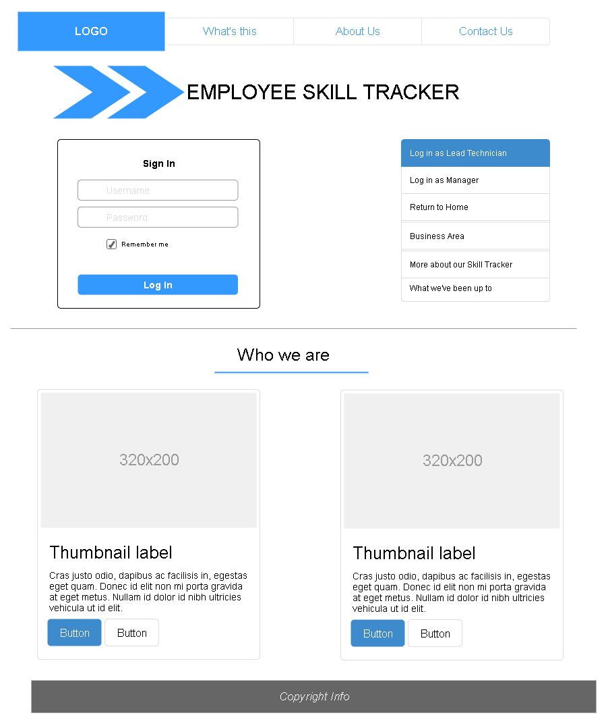
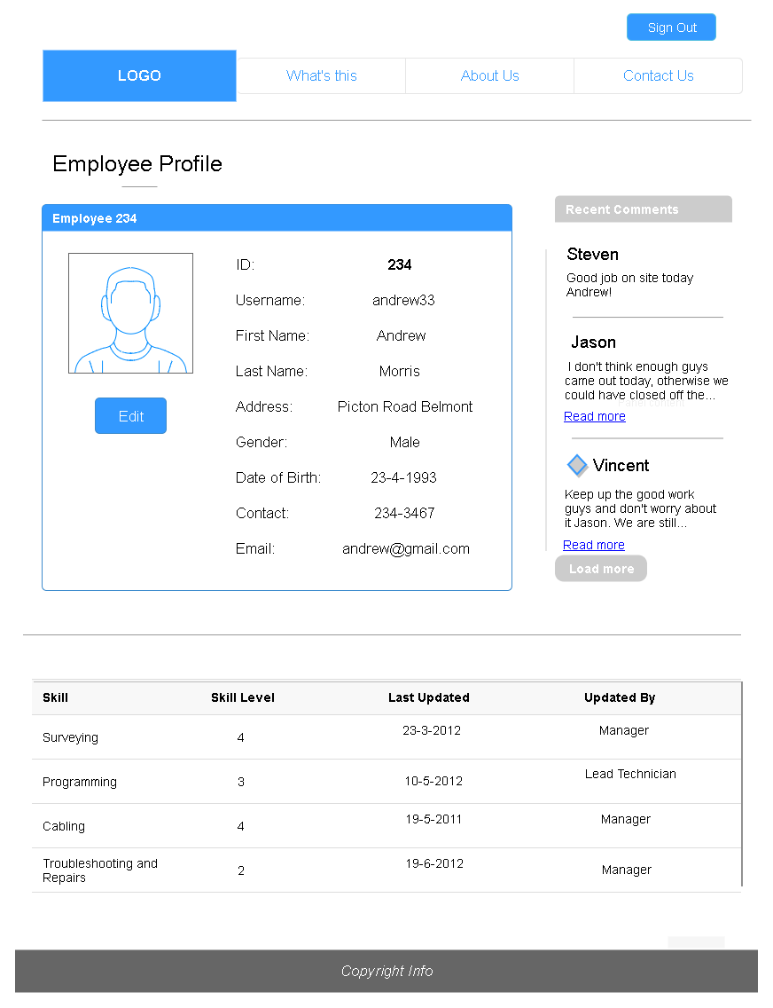

Slide 31
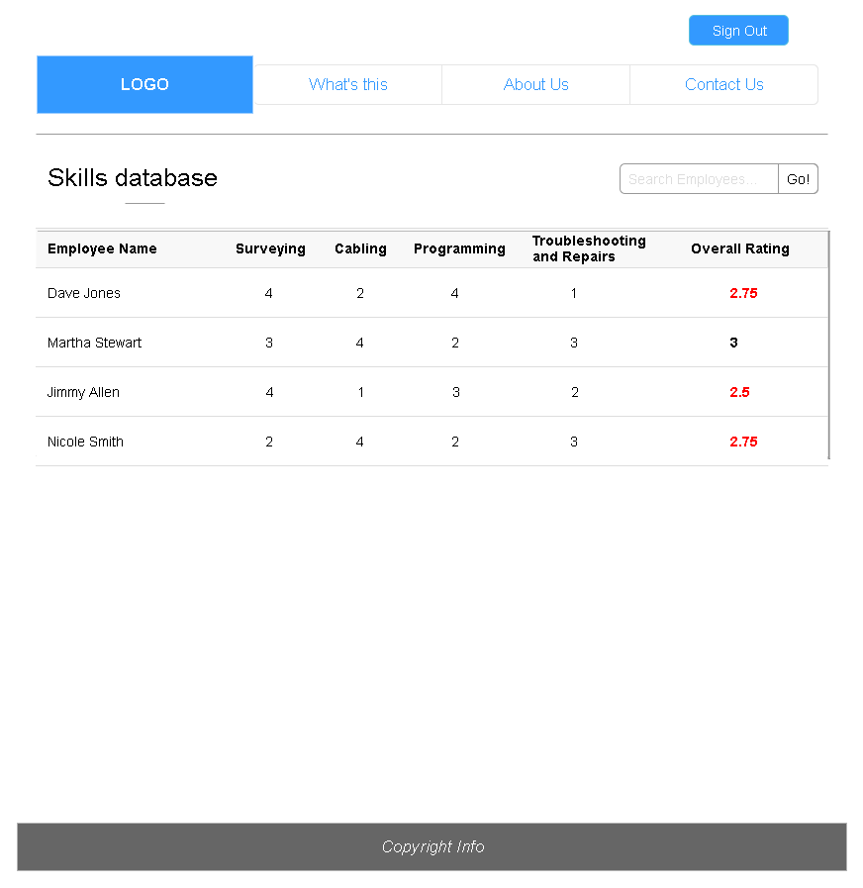

Slide 32
What next?
Decide on which SDLC methodology would be best suited for the project
Create a Work breakdown structure, showing all work that has to be done and the time in which each activity is to be completed
Evaluate possible risks and record them in a Risk register along with ways to mitigate them
Begin development of solution

